Slide 1
Kyber
By Pakin Panawattanakul
24/03/2025
<number>

Slide 2
Presentation outline
Introduction
Objective
What is FPGA
Kyber PKE
Kyber KEM
<number>

Slide 3
Introduction
<number>

Slide 4
Objective
Our group previous presentation
Post quantum cryptography : variations, math problem, performance → Lattice based
Frodo KEM : Lattice based algorithm that haven’t been implement → It is suck !
Today Objective
AJ. Vasin : Find Lattice based cryptography implementation methods on FPGA
Understanding basic idea of Kyber-PKE & Kyber-KEM
<number>

Slide 5
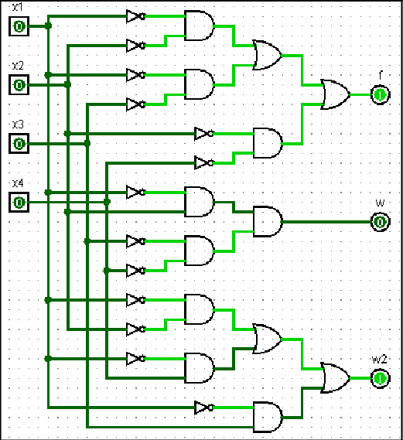
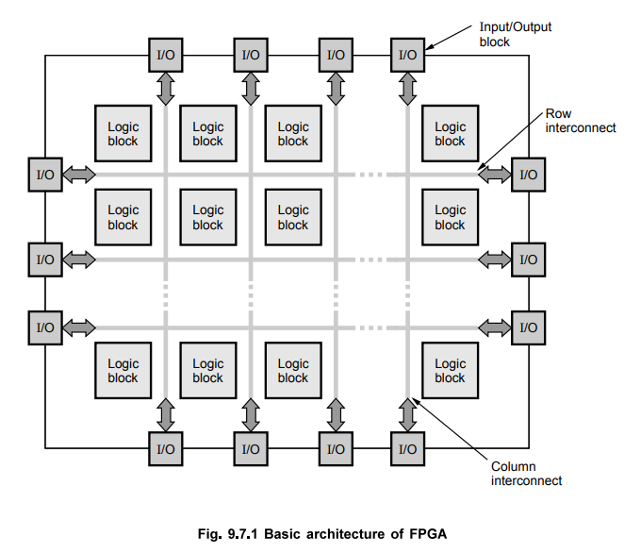
Field programmable gates array
No instruction set like traditional CPU
Reconfigurable Logic Block
Using Hardware description language
E.g. Verilog and VHDL
Parallel execution
Flexibility and Customizable
https://eee.poriyaan.in/topic/fpga--field-programmable-gate-arrays--11689/
https://www.researchgate.net/figure/Digital-circuit-with-two-inputs-OR-and-AND-gates_fig11_309907692
<number>

Slide 6
Kyber-pke & kyber-kem
Base on Module Learning with Error ( Tony’s presentation)
Kyber-KEM chosen to be standard Key encapsulation algorithm by NIST
NIST (National Institute of Standards and Technology) is a U.S. agency that develops and promotes standards for technology, including cybersecurity and cryptography.
<number>

Slide 7
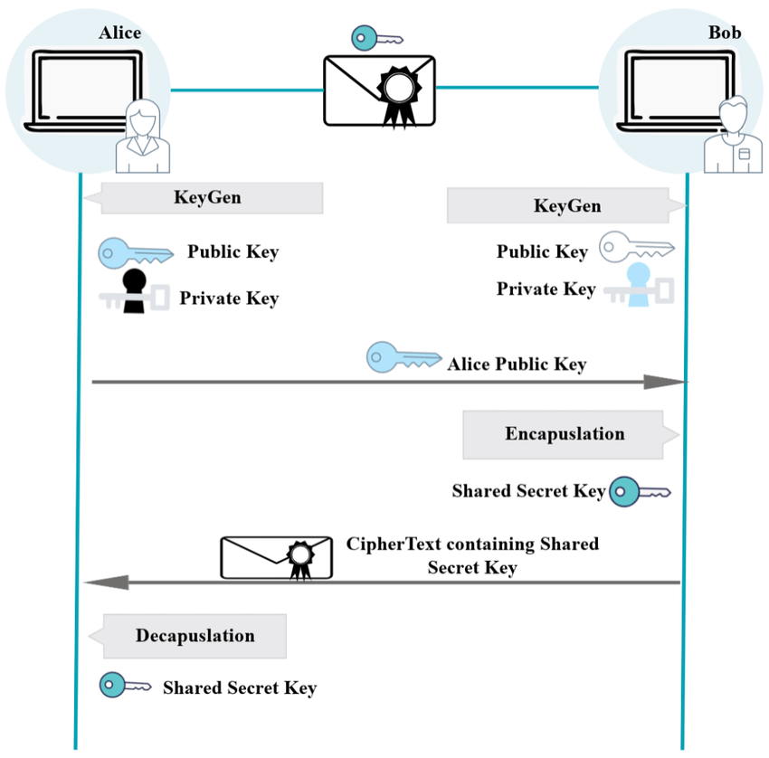
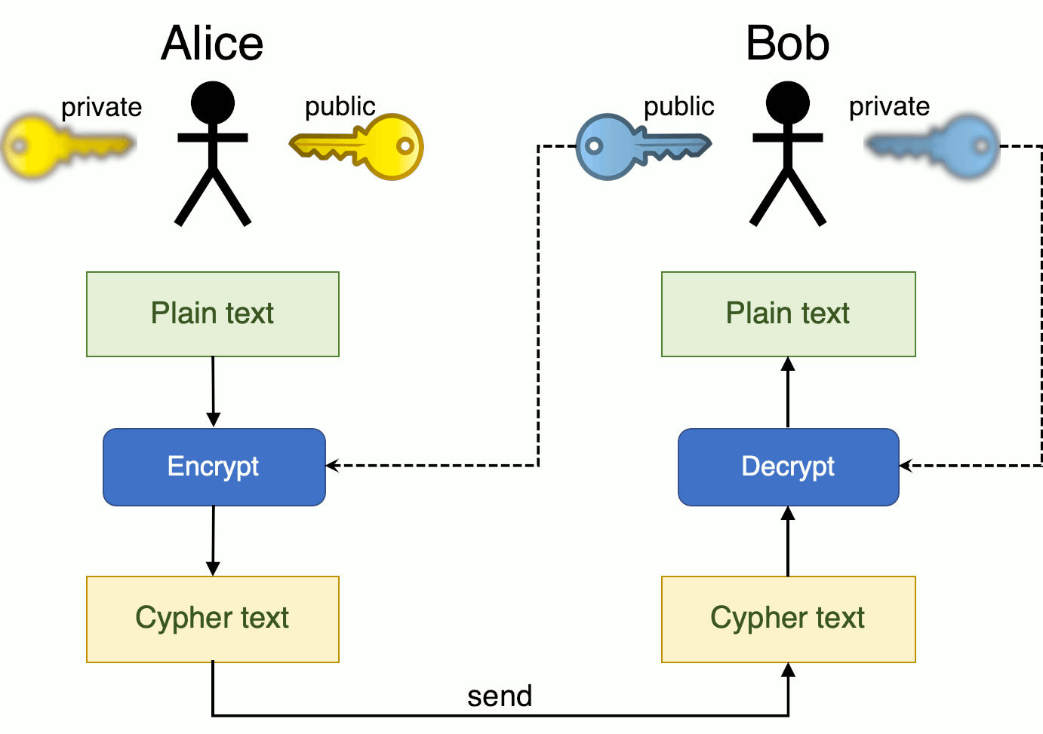
Public key encryption(PKE)
Encrypted message
Key Encapsulation Mechanism (KEM)
Established shared secret key (symmetric key)
https://www.researchgate.net/publication/371388643_Resilience_Optimization_of_Post-Quantum_Cryptography_Key_Encapsulation_Algorithms
https://www.coengoedegebure.com/surviving-an-infosec-job-interview-cryptography/
<number>

Slide 8
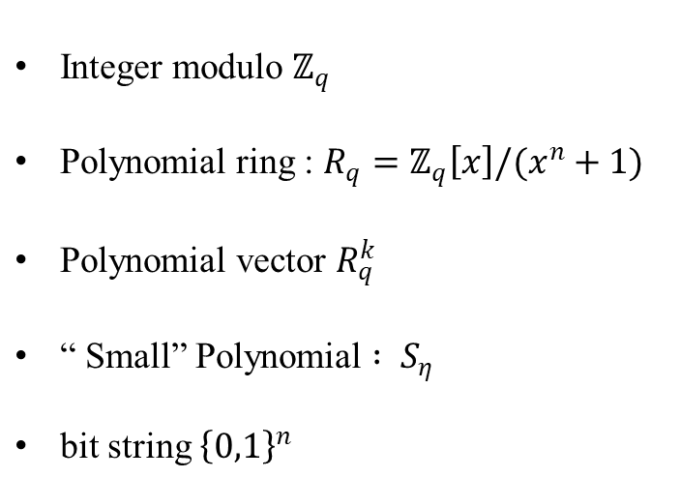
Important math notation
<number>

Slide 9
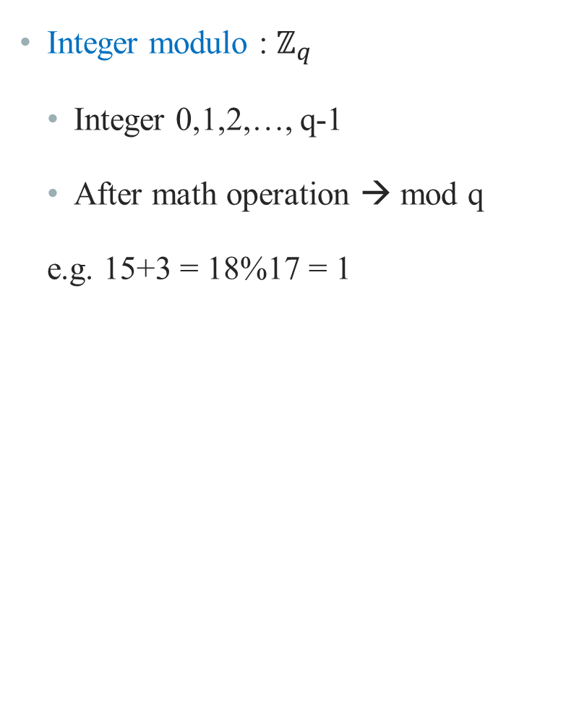
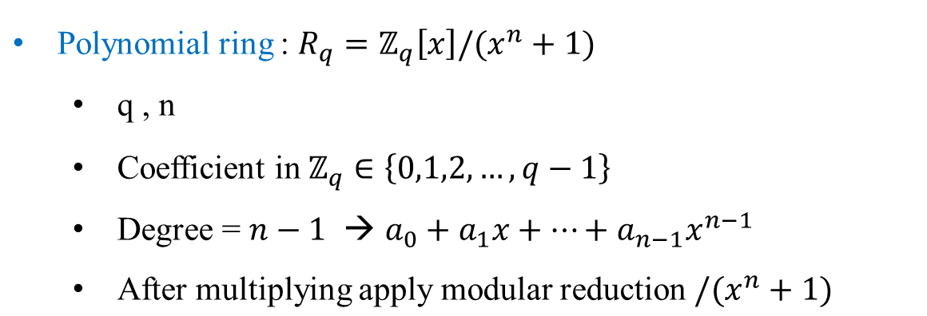
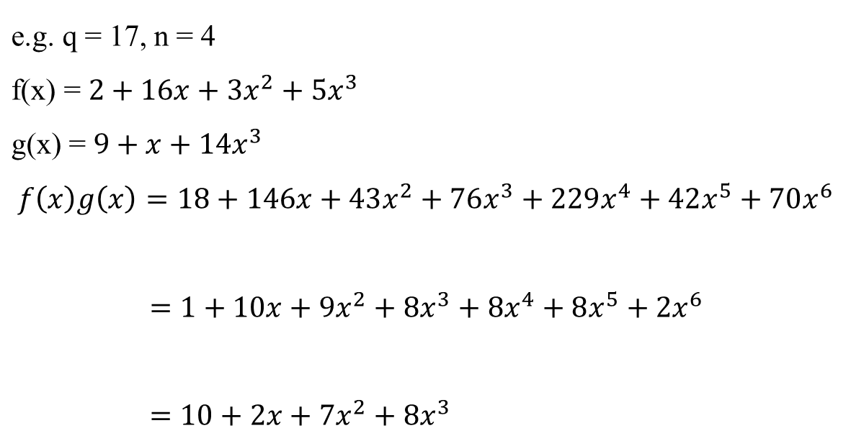
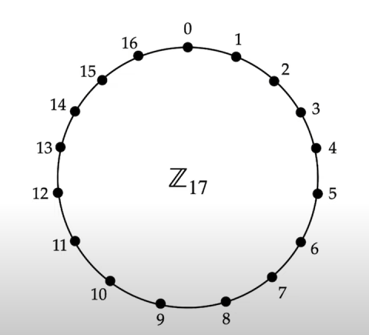

coef. mod q
<number>

Slide 10
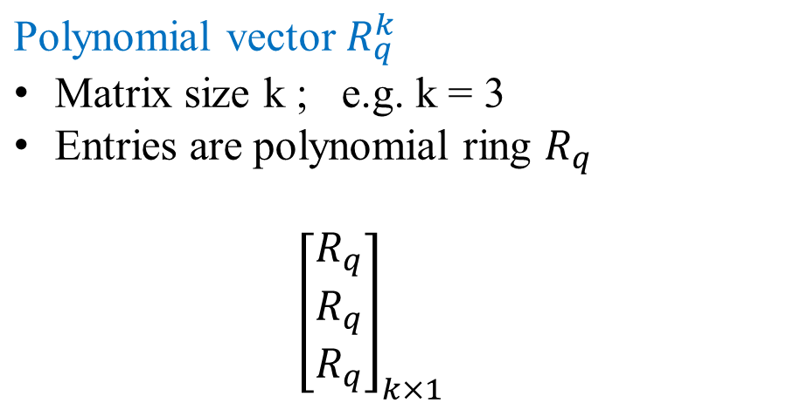
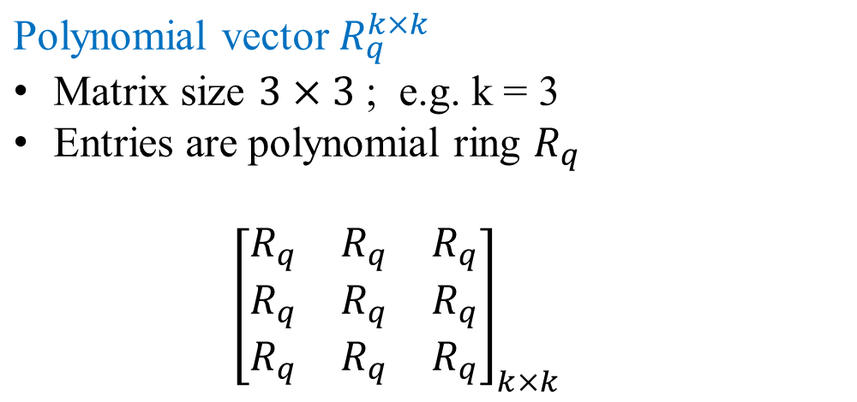
<number>

Slide 11
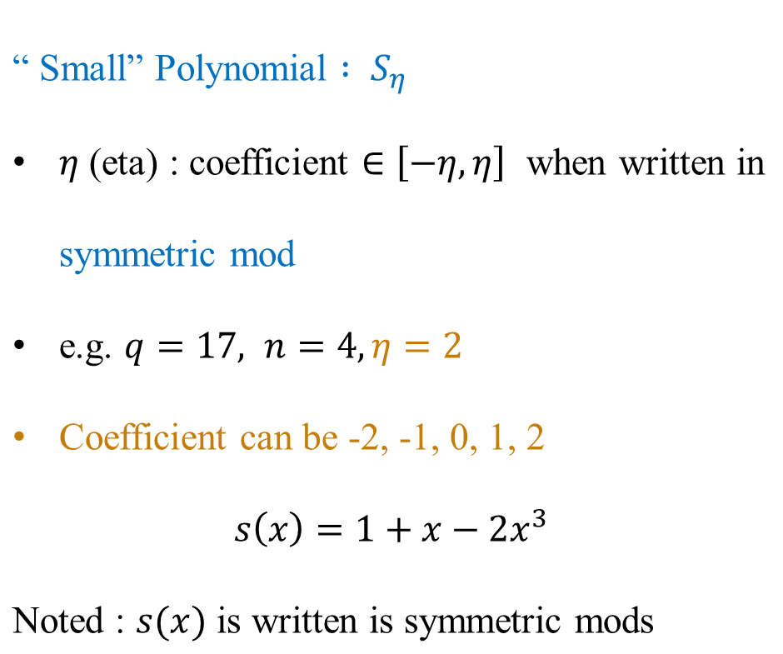
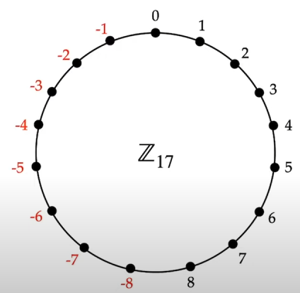


Symmetric mod → mods
<number>

Slide 12
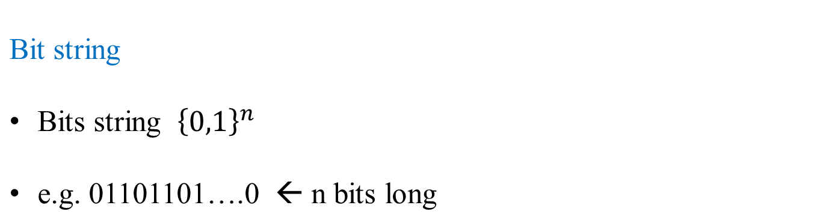
<number>

Slide 13
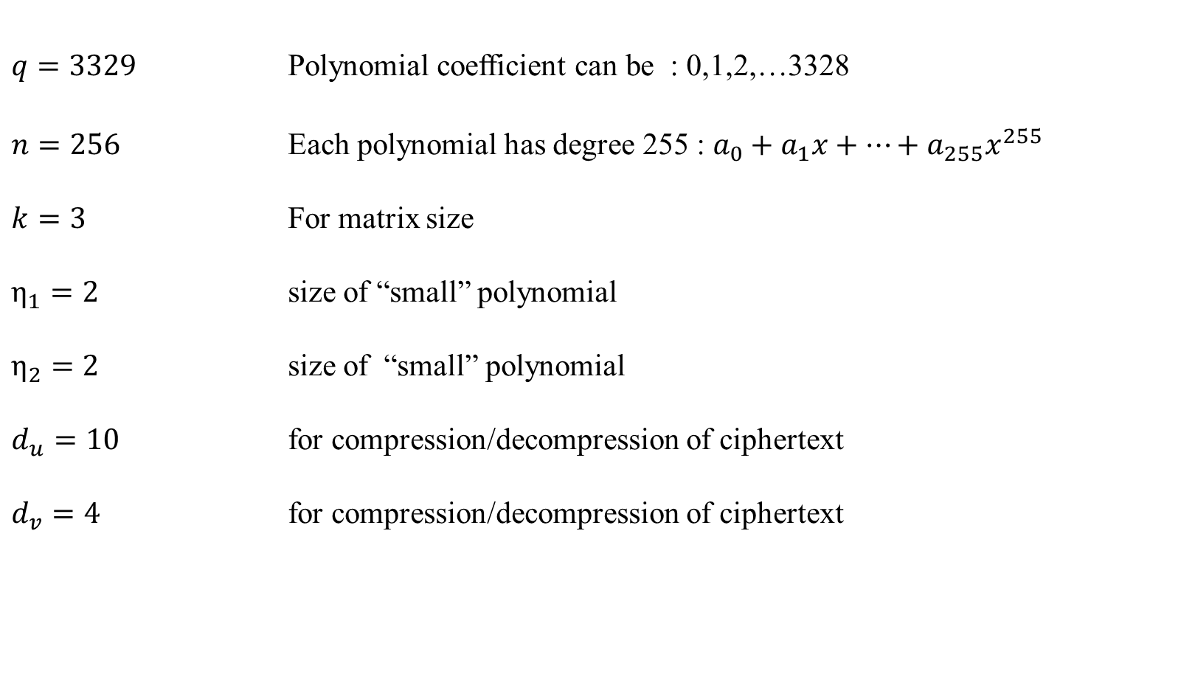
Kyber-768 domain Parameters
<number>

Slide 14
Kyber-pke
Base on Learning with errors problem
Public key encryption
Security level : “secure against chosen plain text attack” → lower than Kyber-KEM
Key generation
Encryption
Decryption
Hash function: generate A : SHAKE 128
<number>

Slide 15
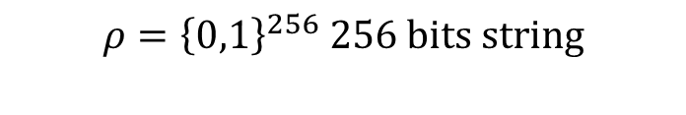
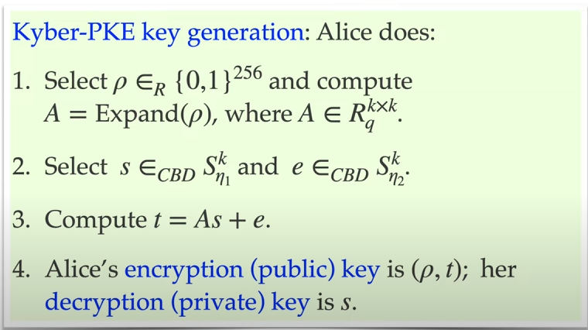

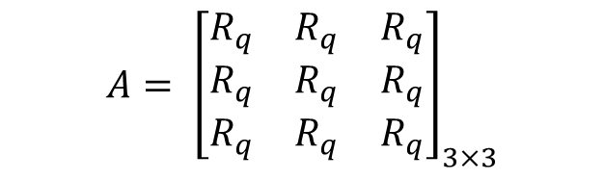
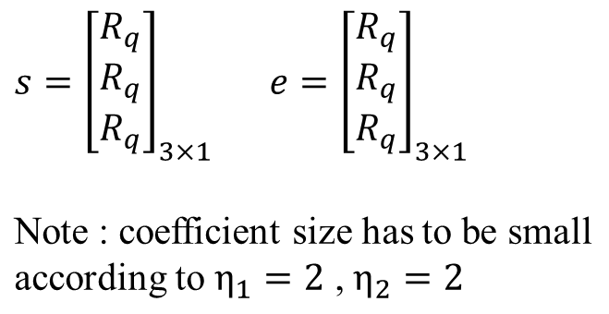
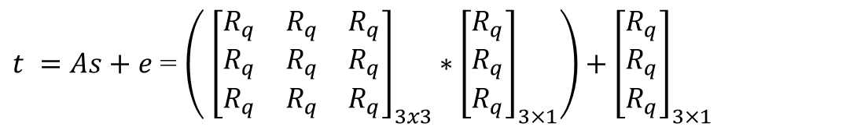
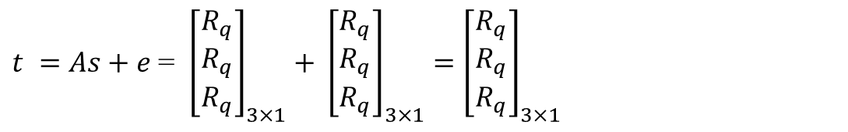
1
2
3
As e t
A s e
<number>

Slide 16
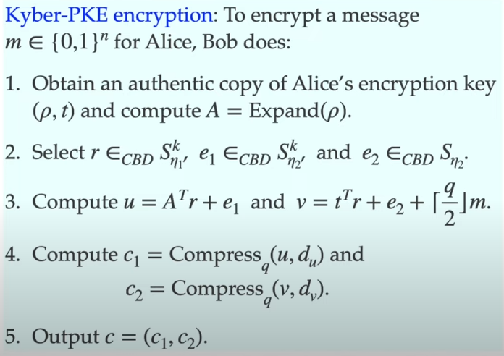
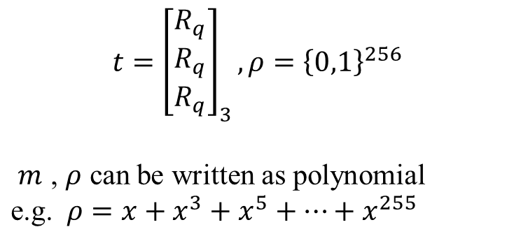
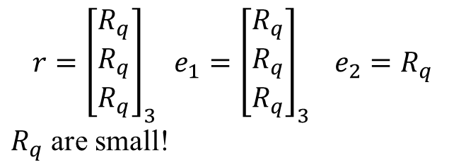
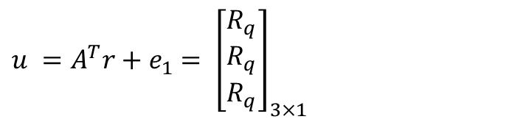
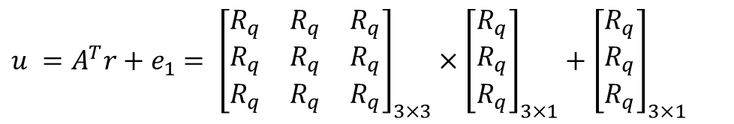
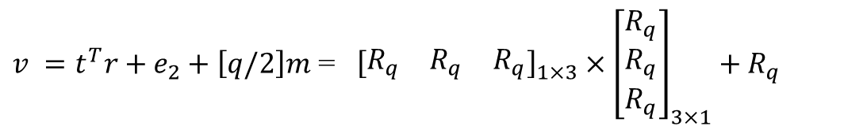


1
2
Ciphertext: send to Alice
3
6

Slide 17
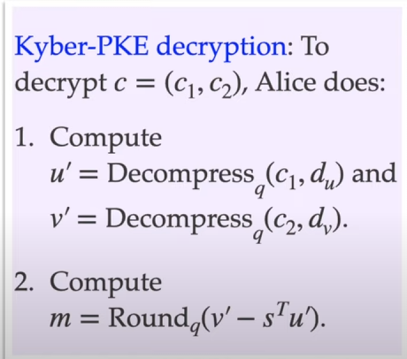
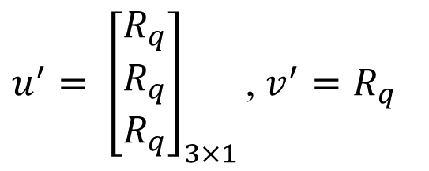
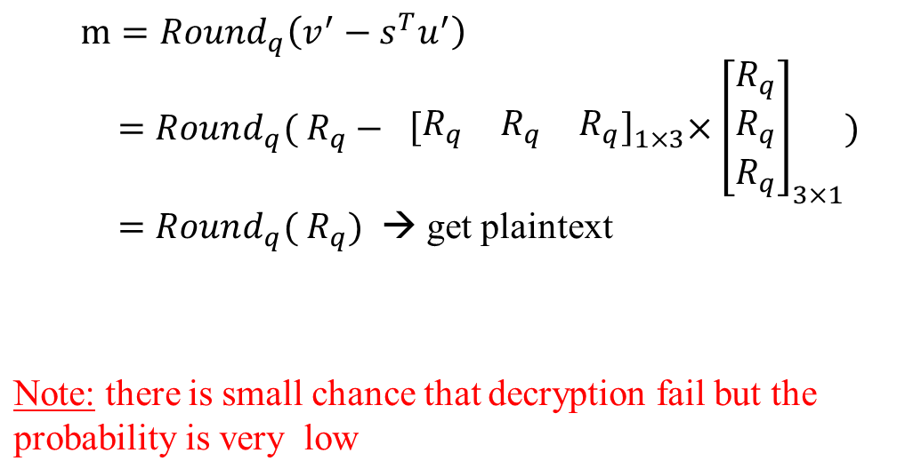
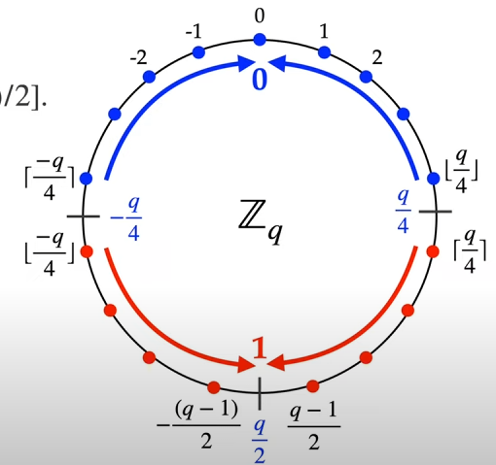
1
2
Bob’s original message
Rounding
<number>

Slide 18
Kyber-KEM
Kyber PKE alone is not secure enough. Applying “Fujisaki Okamoto” transform → Kyber KEM
Key Encapsulation mechanism
Using Kyber-PKE as base building block
Use Hash() and seed to create Pseudo RNG alongside
pure random
Central binomial Distribution
Security : “Secure against chosen ciphertext attack” ( more secure than Kyber-PKE)
Key generation
Encapsulation
Decapsulation
Hash function:
generate A : SHAKE 128
G is SHA3-512, H is SHA3-256, J is SHAKE256
<number>

Slide 19
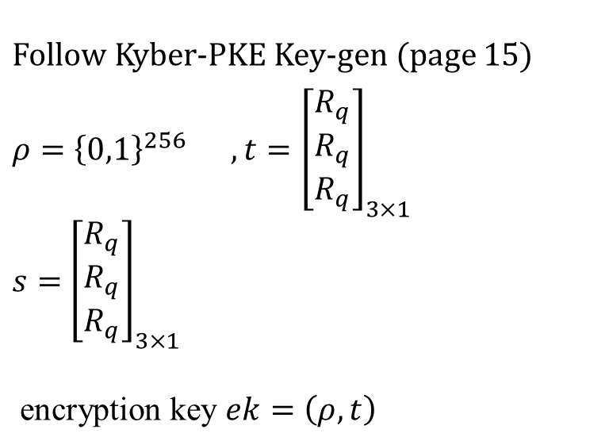
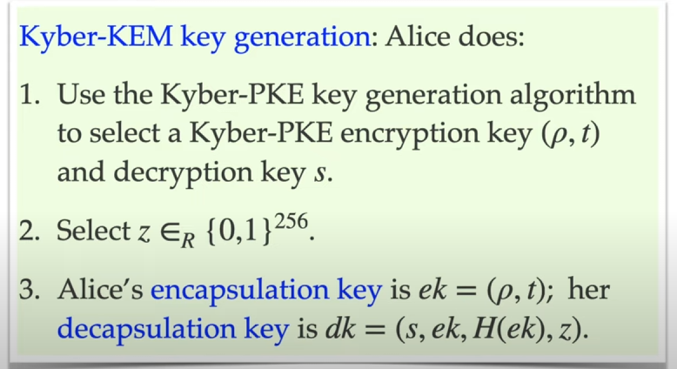
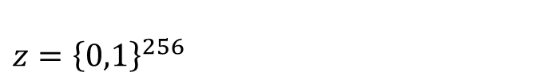
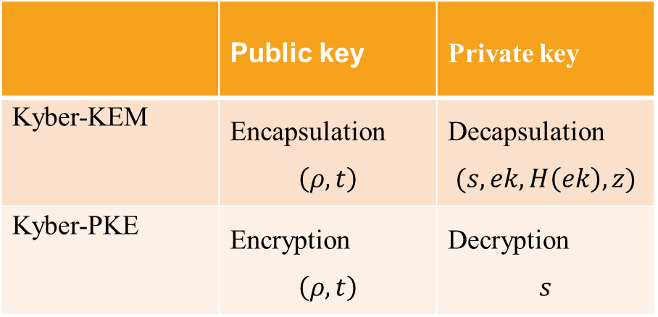
1
2
 | Public key | Private key
Kyber-KEM
Kyber-PKE
Encapsulation key = Encryption key
Decapsulation key != Decryptionkey
<number>

Slide 20
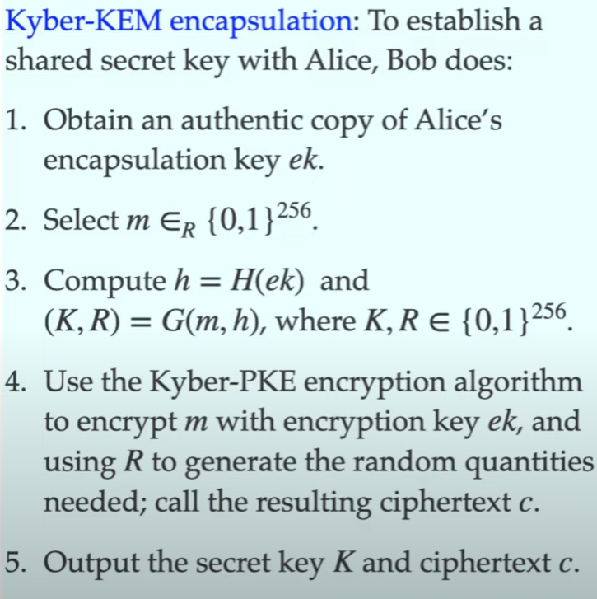
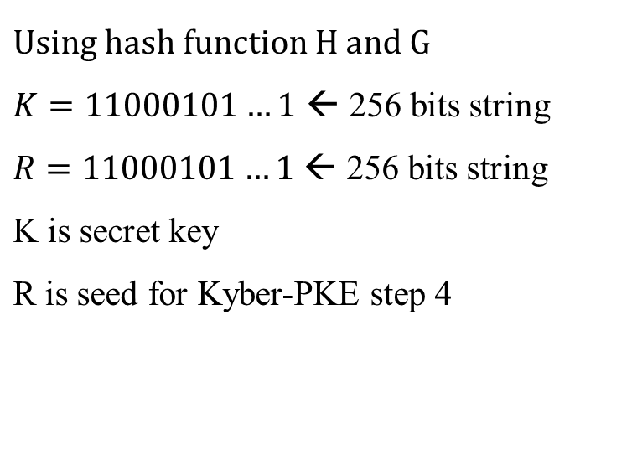
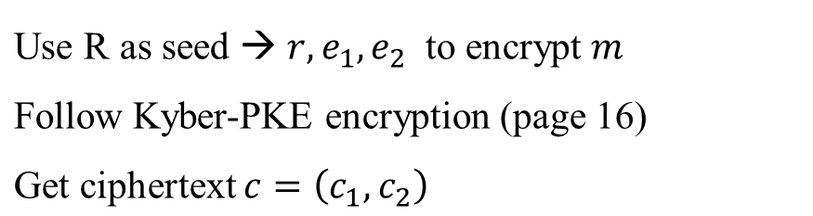
1
2
3
4
Send ciphertext c to Alice
<number>

Slide 21
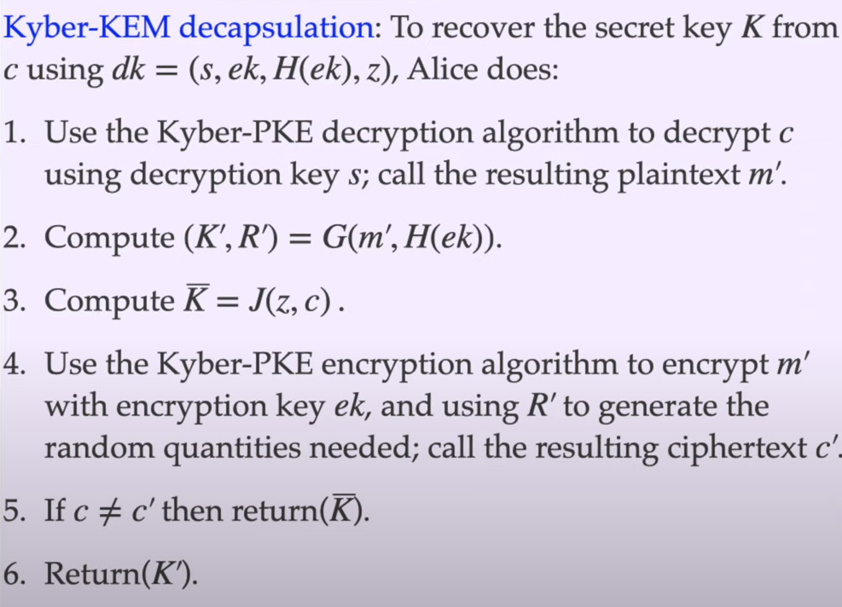
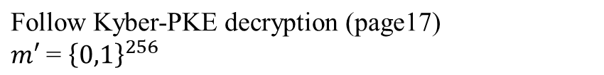
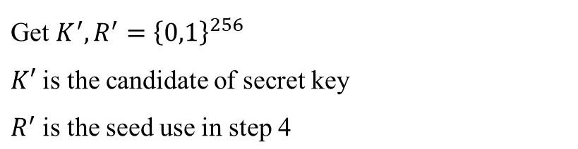
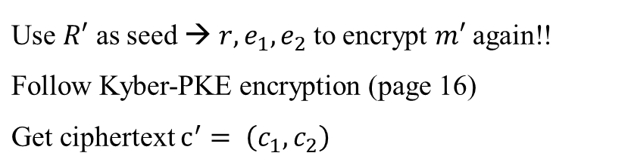
1
2
3
Decapsulation fail
4
Decapsulation successful
<number>

Slide 22
Future work
Literature review : implementation methods of Kyber KEM
Which part of algorithm have been implemented
Which part we could implement, and benefits?
Next presentation : Kyber KEM implementation on FPGA using High Level Synthesis tools
<number>

Slide 23
References
https://eee.poriyaan.in/topic/fpga--field-programmable-gate-arrays--11689/
https://www.researchgate.net/figure/Digital-circuit-with-two-inputs-OR-and-AND-gates_fig11_309907692
https://cryptography101.ca/kyber-dilithium/
<number>

